Slide 1
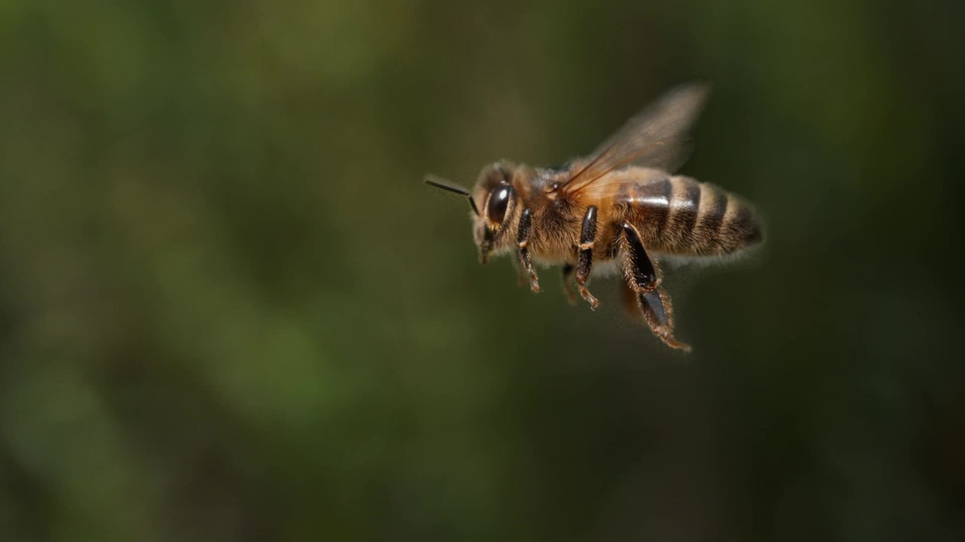
Honeybee Conservation and Preservation Through Data Science
Javier Khaaliq
Faculty Advisor: Dr. Robert Niichel

Slide 2
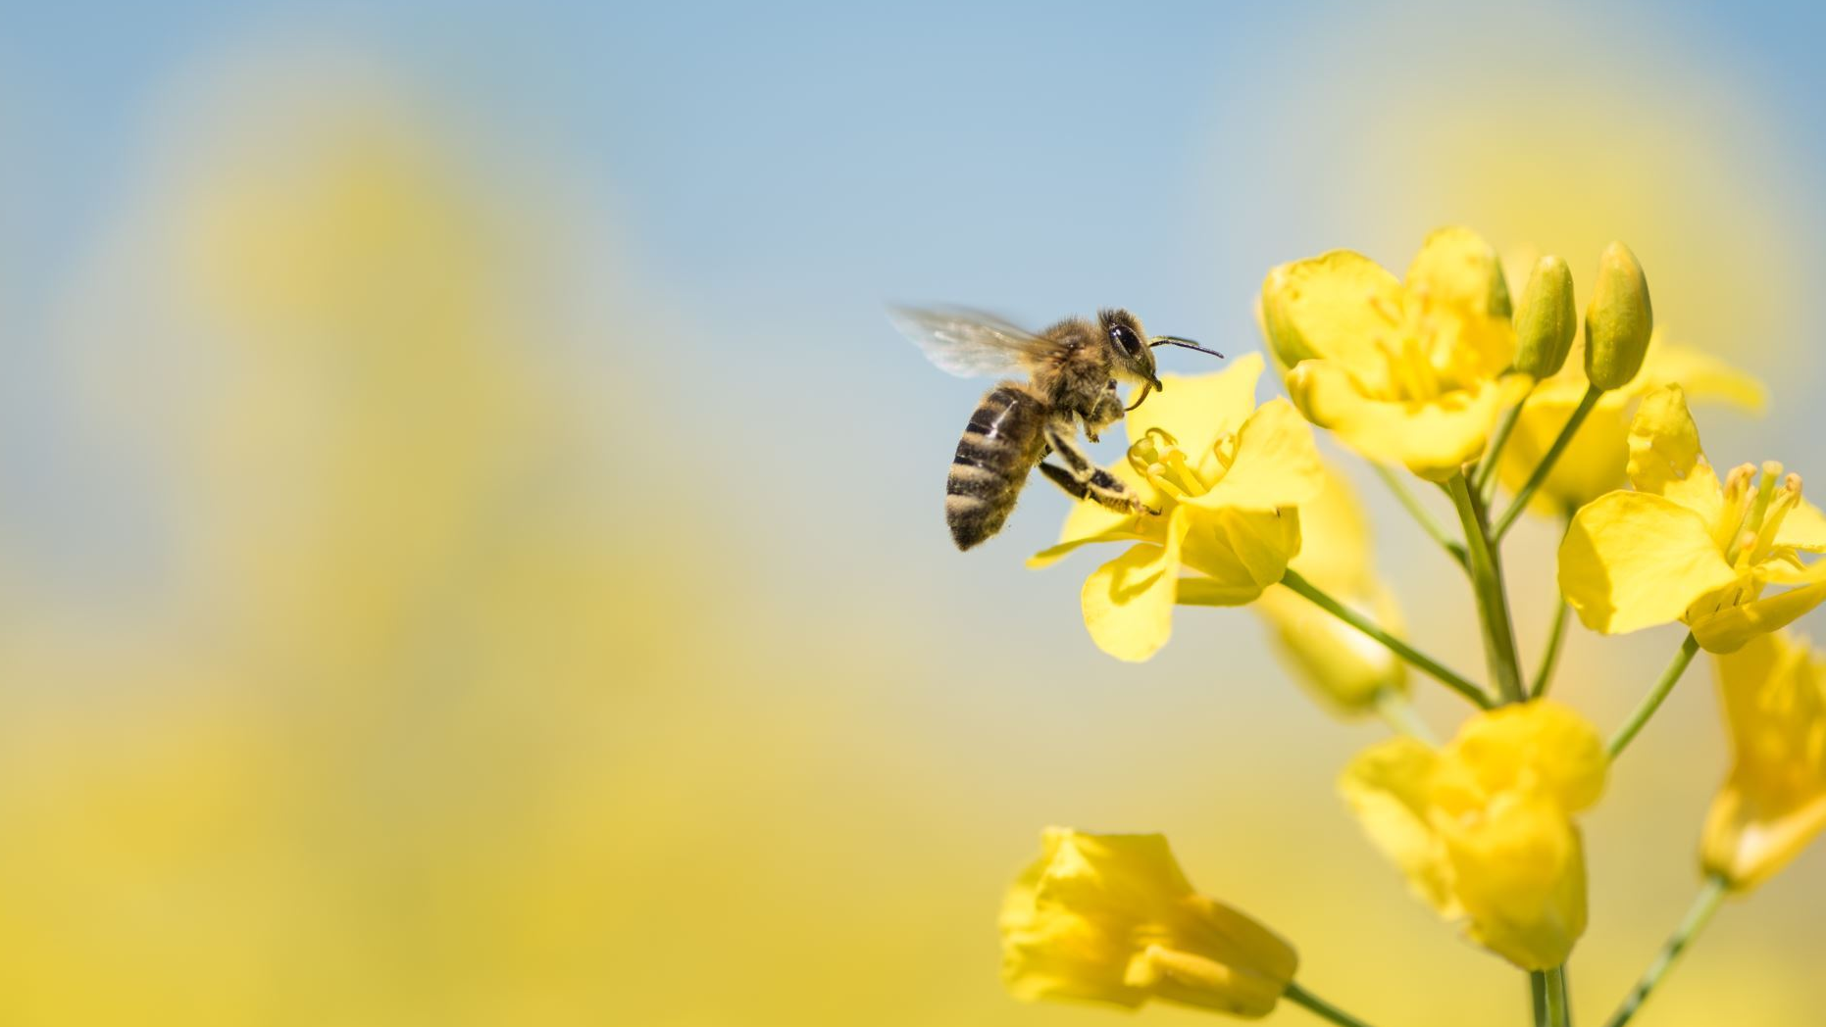
Introduction
Honeybees are important pollinators in our environment.
However, recently their numbers have been declining
How can we preserve this important resource?

Slide 3
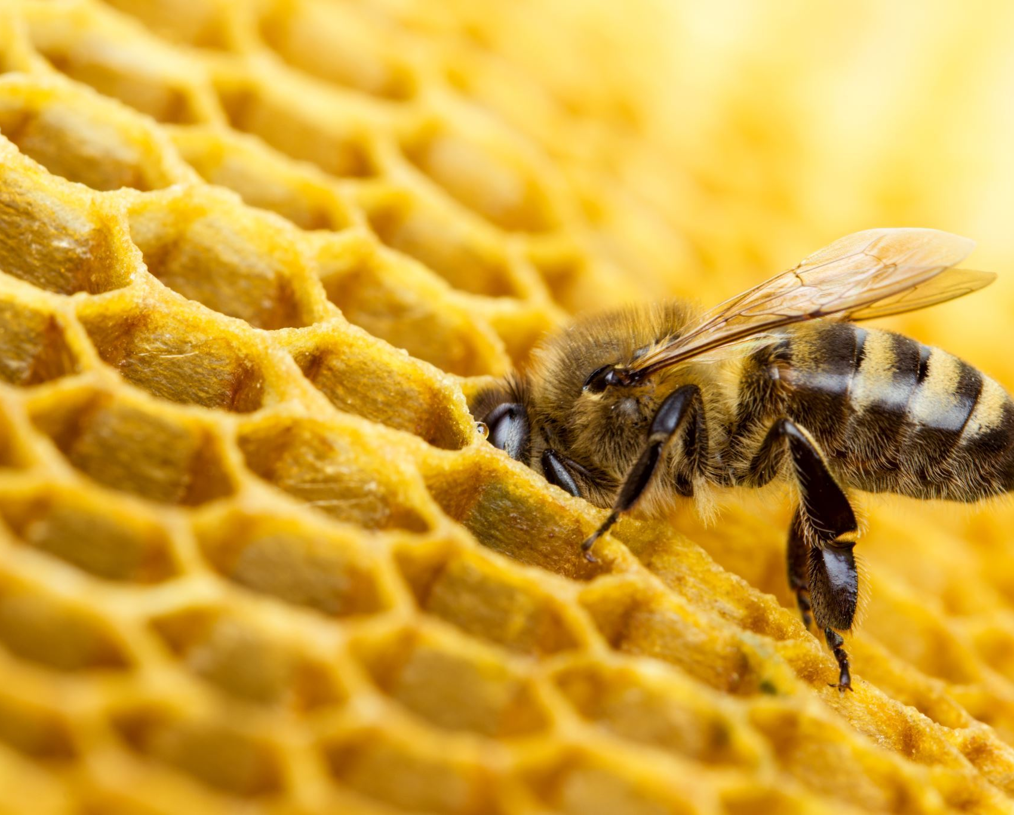
Honeybees
This research project focused on the western honeybee (Apis mellifera). They are social insects which live communally in hives. They utilize "dancing" to communicate the whereabouts and details of food near their hive. Like other bee communities, female honeybees are divided into the workers and queens, which are larger than workers. Males, or drones, are also larger than the workers but are only present in the summer. Workers and queens have stingers, while drones are stingless.

Slide 4
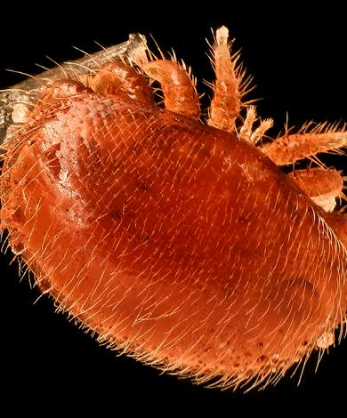
Varroa Mites (Varroa destructor)
Varroa mites are parasitic mites that prey on honeybees and their larvae. They can only reproduce on the brood and females feed on adult honeybees. Female varroa mites are more likely to lay eggs on drone brood (between 10-12 times more) due to the longer brood cycle of drones.

Slide 5
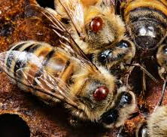
Varroa Mites' Effect on Honeybees
Varroa mites are responsible for causing crippled worker honeybees which suffer from impaired flight performance, low hive return rates, reduced lifespans, and concerningly lower weight. Their impact on colonies include abnormal brood patterns, sunken and chewed cappings and larvae slumped in the bottom or side of the cell. This causes a decrease in hive population which will eventually lead to colony failure and death.

Slide 6
Research Goal
We considered the following questions for research:
Can we predict varroa populations for honeybee hives?
What is the best statistical method to predict varroa populations?

Slide 7
Methodology
We focused on implementing a few statistical techniques on pre-existing datasets to uncover patterns and find possible applications for preserving honeybee populations and preventing hive loss.
All research was done using Python, Pandas, and other statistical programming tools.
Models were validated by comparing their mean squared error (MSE), root mean squared error (RMSE), and/or cross validation.

Slide 8
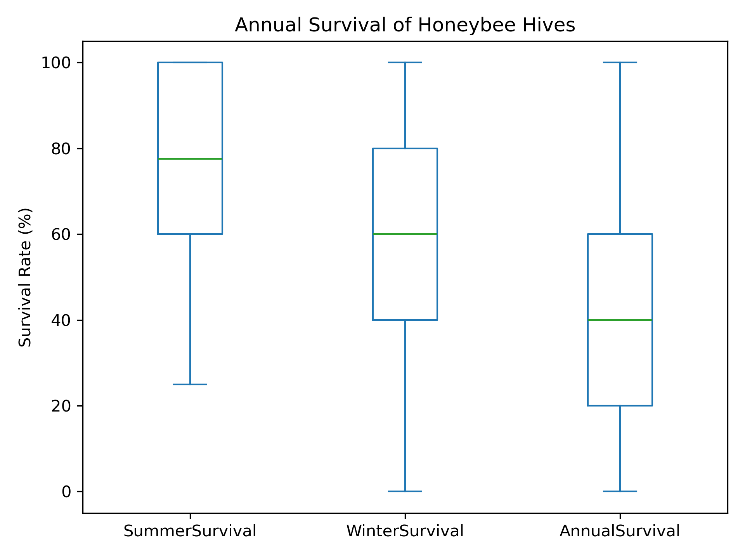
Box Plot Results
The study had multiple sites, each with 2-5 hives active. Survival rates were recorded over the course of one year.
Unsurprisingly, honeybees survive the summer better than they do the winter.
Note that most sites have a low chance of annual survival.

Slide 9
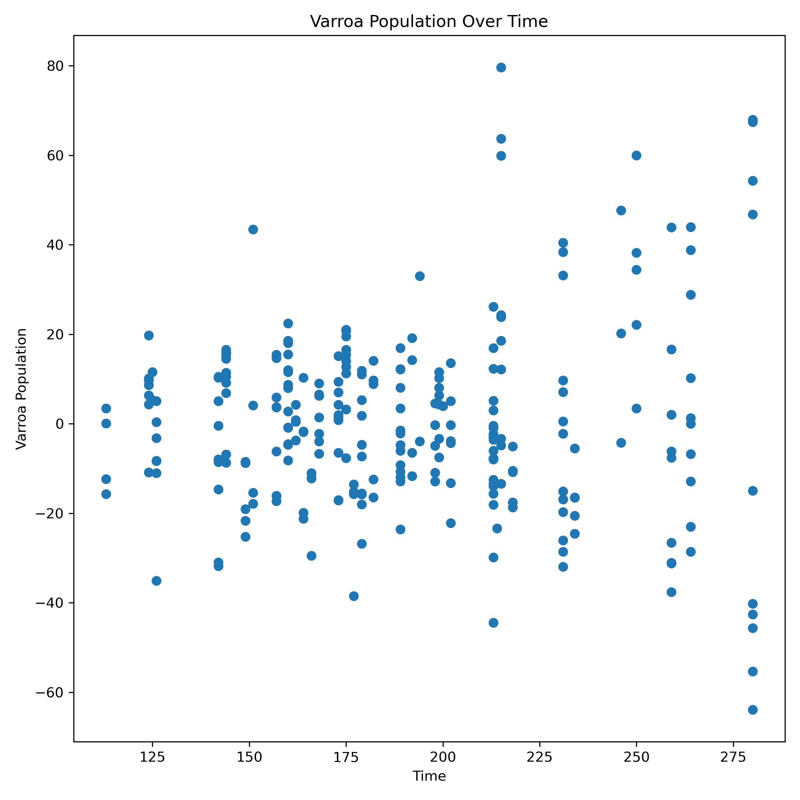
Varroa Growth over a Year
Varroa population in our data set was centralized, meaning it can take on negative values.
The time axis is in days measured from January 1, 2015.
There are no real trends (correlation) here based on time—is there a better way to predict Varroa pop?

Slide 10
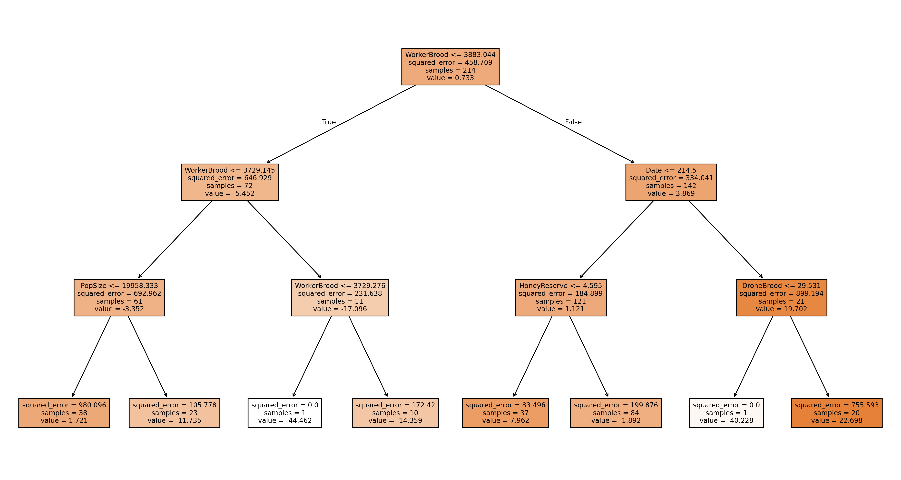
Regression Tree Model Results (pt. 1)

Slide 11
Regression Tree Model Results (pt. 2)
Hives with lower populations and worker brood sizes tend to have a lower-than-average Varroa population.
On the other hand, a higher worker brood implies a higher-than-average Varroa population. We also found that varroa mites aren't as prevalent in hives with a lower honey reserve.
Additionally, our tree model confirms a previously mentioned statement that varroa mites prefer drone broods as varroa levels are highest in hives with high drone broods.

Slide 12
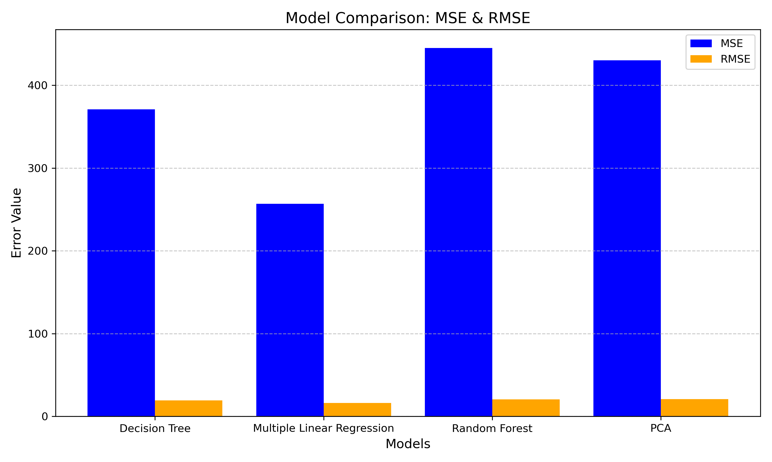
Overall Model Comparison
Our decision tree, random forest, and principal component analysis (PCA) models all had higher MSE and RMSE compared to multiple linear regression (MLR). However, the MLR model is less intuitive than the DT model.

Slide 13
Assumptions and Conclusion
Our results allow us to assume the following for better conservation of honeybees:
We should keep an eye on drone broods due to their role as better suited incubators for varroa larvae. This is especially true for the summer months.
Worker broods also prove important for predicting varroa mites, but we must consider the hive's honey reserve and brood sizes for better prediction of varroa infestation. Therefore, worker brood monitoring would require more caution and delicacy than drone brood monitoring would require.

Slide 14
Acknowledgements
This research was made possible by NASA West Virginia Space Grant Consortium, Training Grant #80NSSC20M0055.

Slide 15
References
https://beeaware.org.au/archive-pest/varroa-mites/#ad-image-0
https://besjournals.onlinelibrary.wiley.com/doi/10.1111/1365-2664.12836
https://www.britannica.com/animal/honeybee

